Slide 1
Detecting Contradiction and Entailment in Multilingual-Text
Presented By :- Babak Ebrahimi & Aakash Shah

Slide 2
Abstract
Fact-Checking, Identifying Fake News, Analyzing text are always case of Question Mark.
So, Natural Language Processing can be applied on it.
In this project, we tackle the problem of detecting Contradiction and Entailment in multilingual text.

Slide 3
Problem Statement
Premises : ‘He came, he opened the door and I remember looking back and seeing the expression on his face, and I could tell that he was disappointed’.
Hypothesis 1 - Just by the look on his face when he came through the door I just knew that he was let down.
Category : Entailment
Hypothesis 2 - He was trying not to make us feel guilty but we knew we had caused him trouble.
Category : Neutral
Hypothesis 3 - He was so excited and bursting with joy that he practically knocked the door off it's frame.
Category : Contradiction

Slide 4
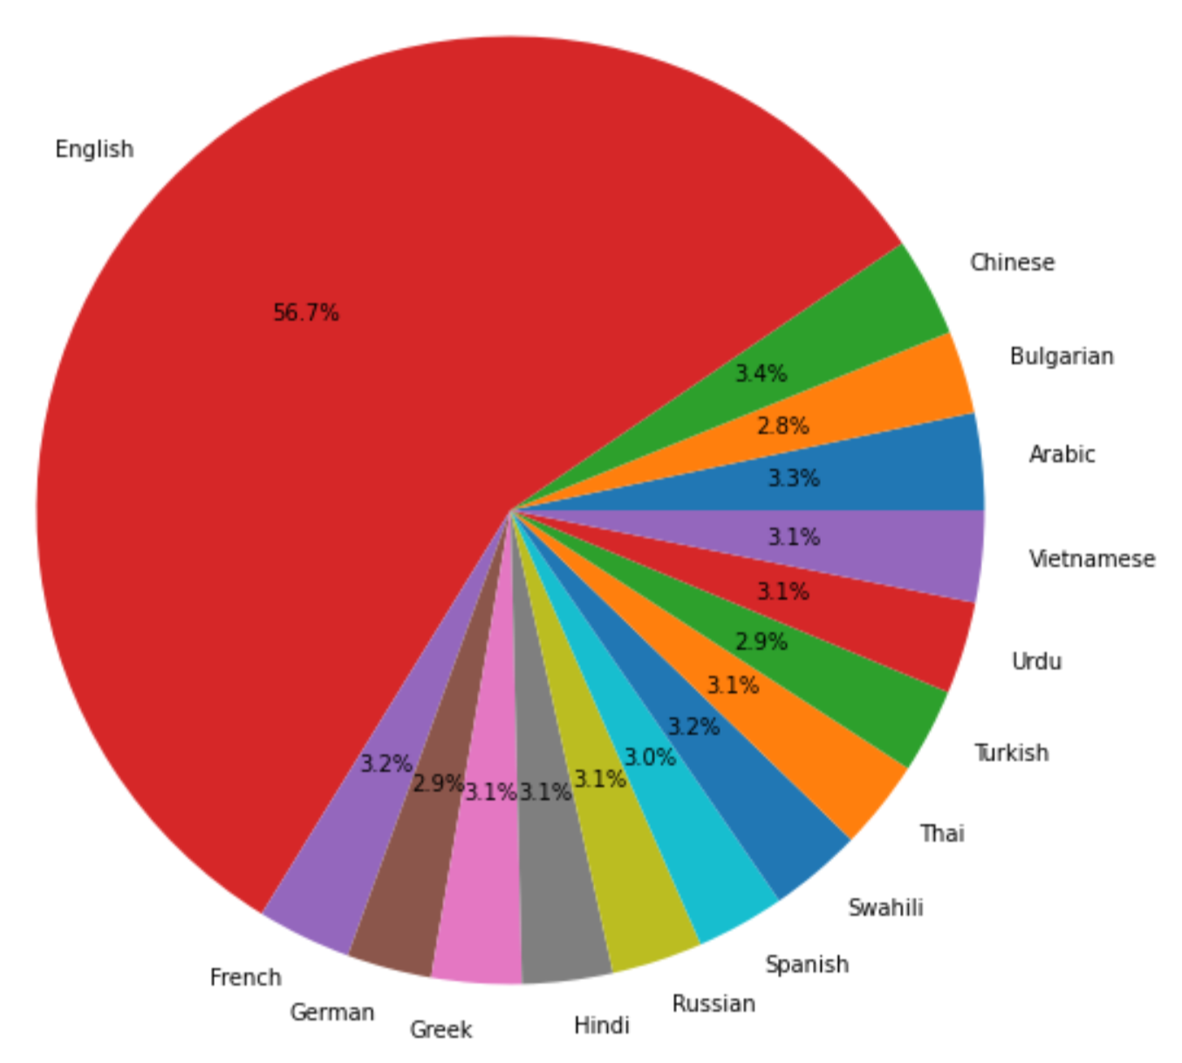
Dataset
Kaggle Website
The Dataset Comprises of columns like ID, Premises, Hypothesis, Langabv, Language and label.
15 Languages like Arabic, Bulgarian, Chinese, German, Greek, English, Spanish, French, Hindi, Russian, Swahili, Thai, Turkish, Urdu, and Vietnamese.

Slide 5
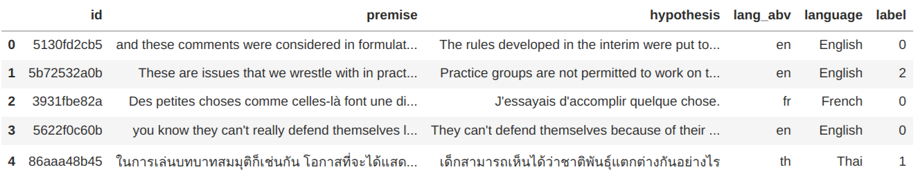
Dataset

Slide 6
Related Work
The BERT model achieves competitive results on various NLU tasks, as shown from its performance on the GLUE benchmark.
Devlin and Conneau in mBERT and XLM:
masked language models
trained on many languages without the need for cross-lingual supervision.
On the cross-lingual natural language inference (XNLI) benchmark
Huang showed gains over XLM using cross-lingual multi-task learning,
Singh demonstrated the efficiency of cross-lingual data augmentation for cross-lingual NLI.
RoBERTa shows that training BERT longer on more data leads to significant boost in performance.
XLM-Roberta train on cleaned Common Crawls , which increase the amount of data for low-resource languages by two orders of magnitude on average.

Slide 7
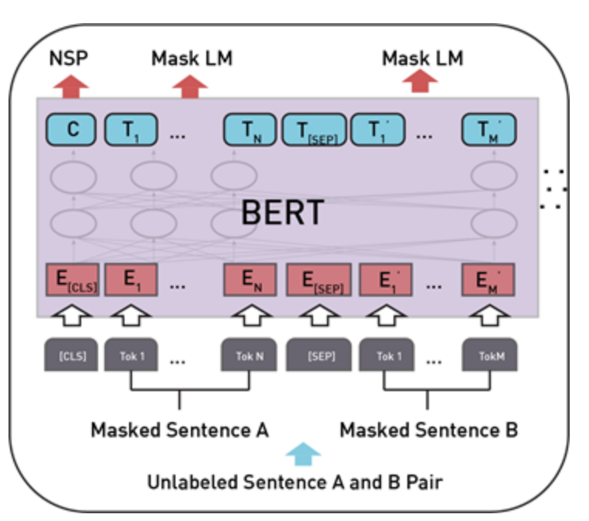
BERT (Bidirectional Encoder Representations from Transformers)
BERT, which stands for Bidirectional Encoder Representations from Transformers, is based on Transformers, a deep learning model in which every output element is connected to every input element, and the weightings between them are dynamically calculated based upon their connection.

Slide 8
XLM-RoBERTa
XLM-RoBERTa (XLM-R) is a pre-trained multilingual model that outperforms multilingual BERT.
XLM means Cross-lingual Language Model.
Four Versions:
Xlm-roberta-base
Xlm-roberta-large
Xlm-roberta-xl (still code is not available in transformer library)
Xlm-roberta-xxl(still code is not available in transformer library)

Slide 9
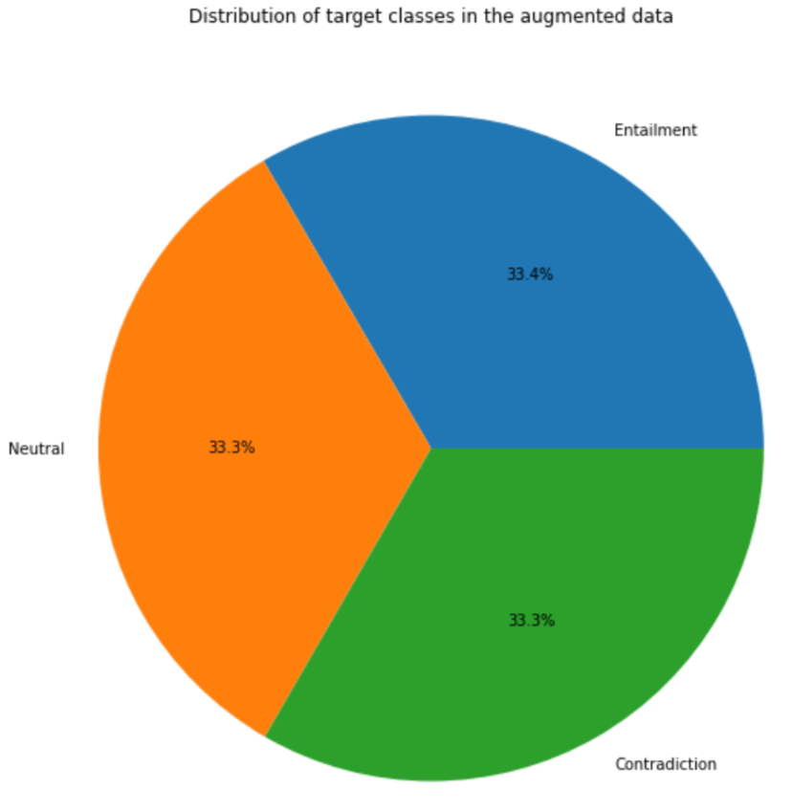
Our implementation:
First approach: XLM-RoBERTa-large
Second approach: XLM-RoBERTa-large with dense layer head and Augmenting XNLI data

Slide 10
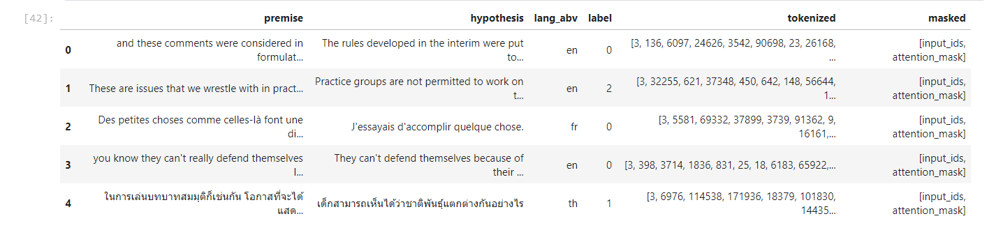
Sample inputs and embeddings

Slide 11
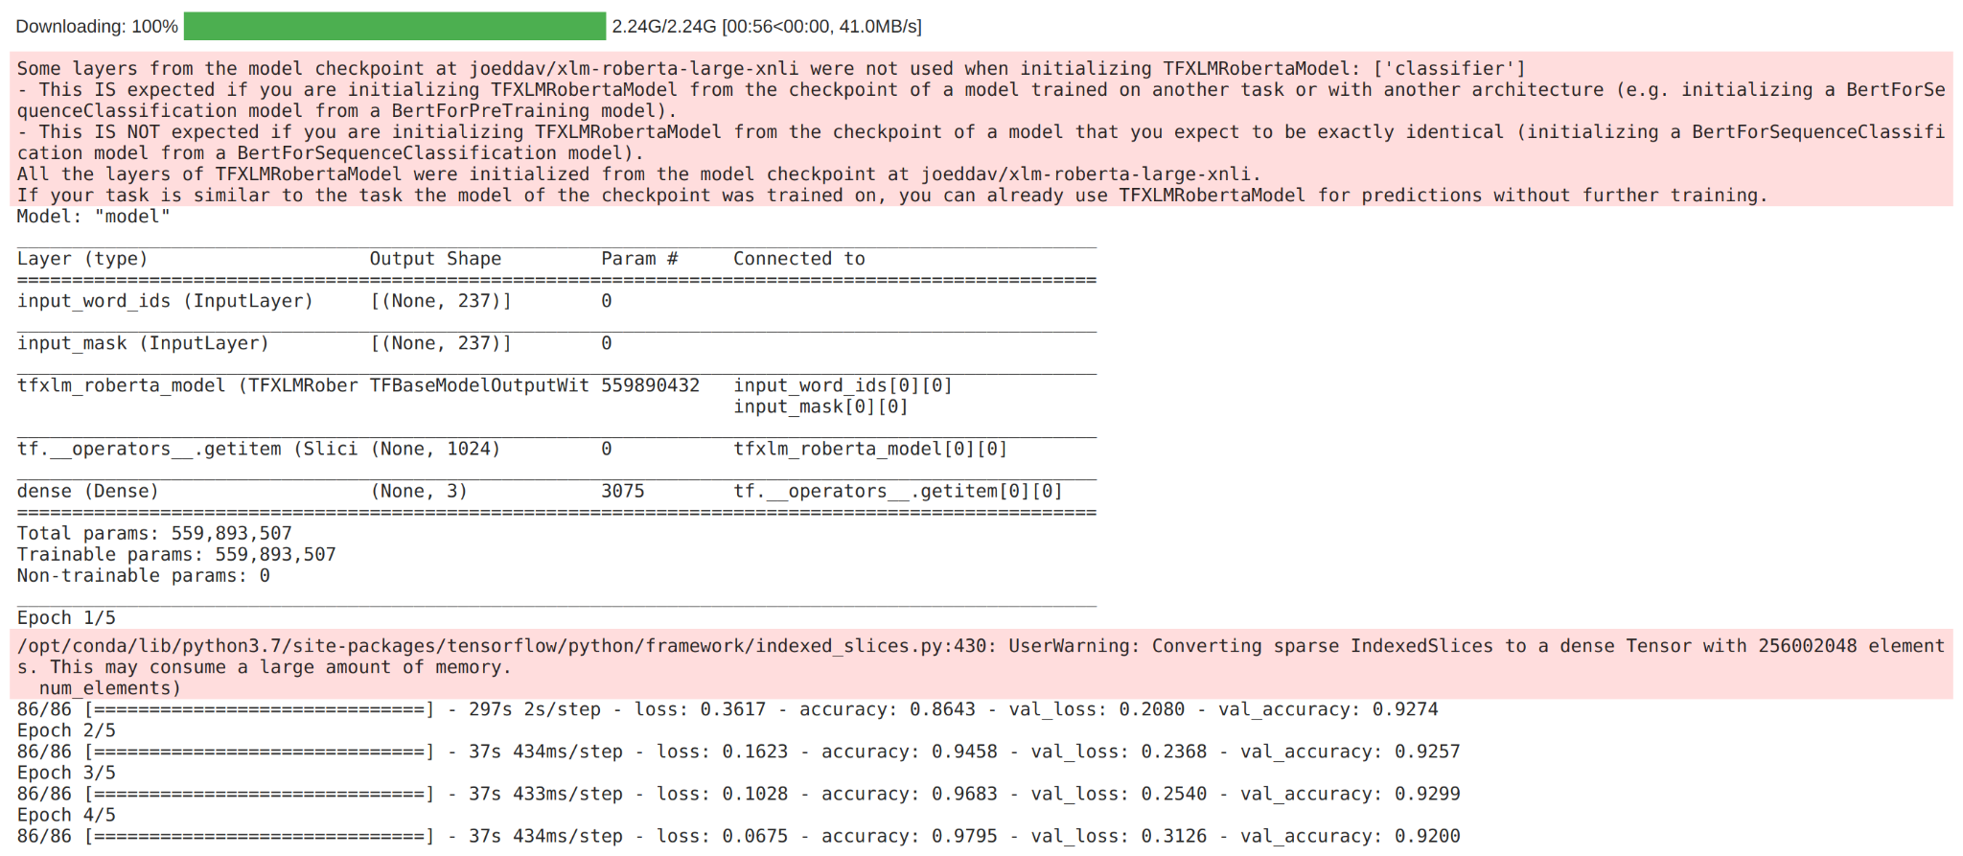
Results of first approach(XLM-RoBERTa-large):

Slide 12
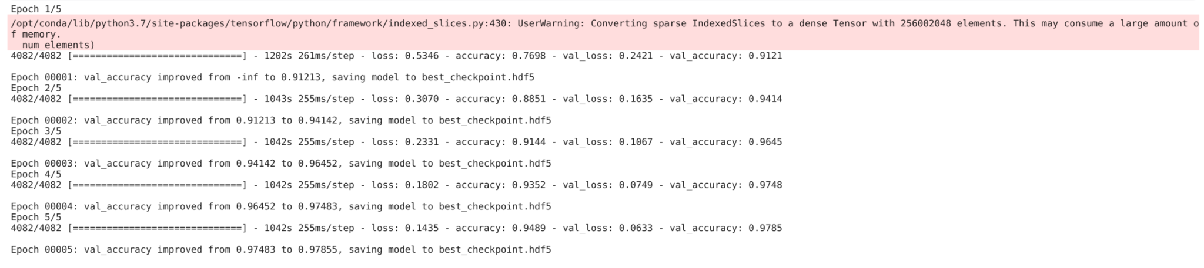
Results of second approach(XLM-RoBERTa-large with dense layer head and Augmenting XNLI data):

Slide 13
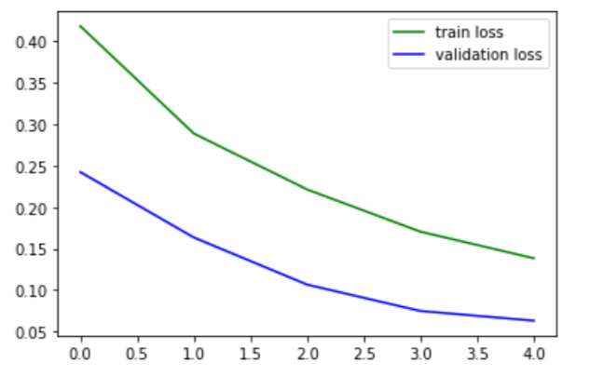
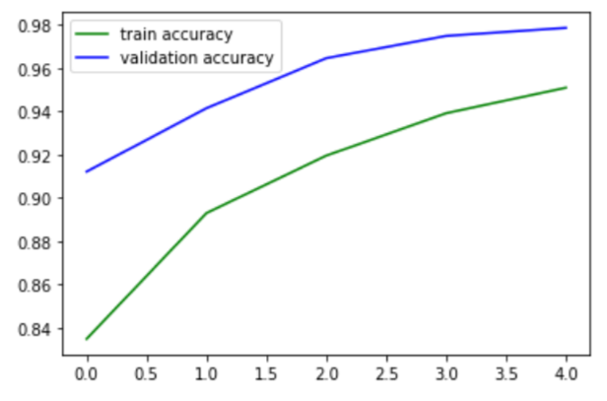
Results of second approach (loss and accuracy during training):

Slide 14
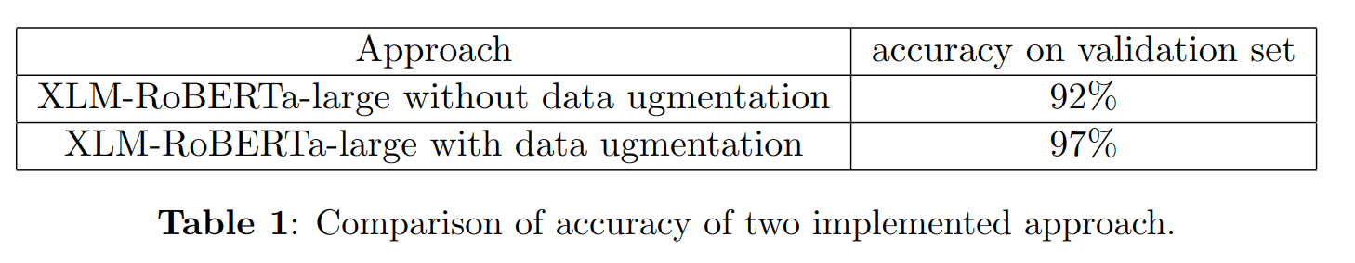
Summary of results and Conclusion:
Conclusion: Using data augmentation and dense layer head increased the accuracy of the model

Slide 15
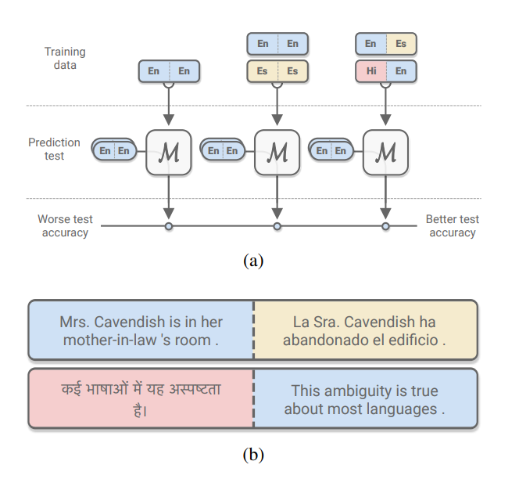
Future work
using XLDA: Cross-Lingual Data Augmentation
Using Xlm-roberta-xl which is a larger network (7 times more parameters than Xlm-roberta-large ) and trained on more data

